Slide 1
Dashboard Design
NAME – SUNAYANA PANIGRAHI
DATE – 27/06/2025
TOOLS USED - TABLEAU

Slide 2
OBJECTIVE
To visualize and analyze key business metrics like Sales, Profit, and Growth.
Identify trends over time and segment performance using interactive filters.
Provide actionable insights for decision-making.

Slide 3
DATASET OVERVIEW
Source: Sample Superstore dataset.
Records: ~10,000 orders.
Columns include: Order Date, Region, Category, Sales, Product Name, Product ID etc.

Slide 4
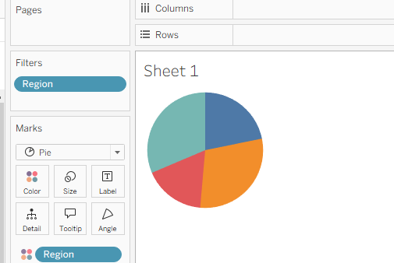
SALES BY REGION
The sales data is divided across four main regions: West, East, Central, and South.
West Region consistently records the highest sales, driven by strong performance in California and Washington.
East Region follows closely, especially boosted by cities like
New York and Boston.
Central Region shows moderate sales, with room for improvement in customer engagement and category focus.
South Region has the lowest overall sales, indicating a potential
market for targeted promotions or product expansion.

Slide 5
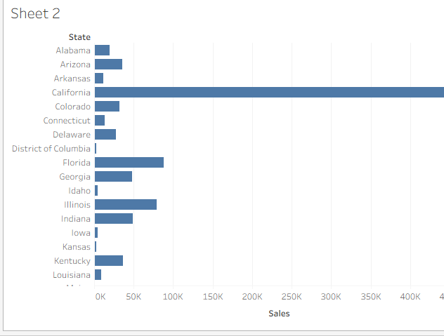
SALES BY STATE
California leads with the highest sales, contributing a large share of overall revenue.
New York and Texas also perform strongly, driven by
large customer bases and frequent orders.
Other high-performing states include Washington,
Pennsylvania, and Florida.
States like North Dakota, Wyoming, and West Virginia
show very low sales, indicating underdeveloped markets
or low demand.

Slide 6
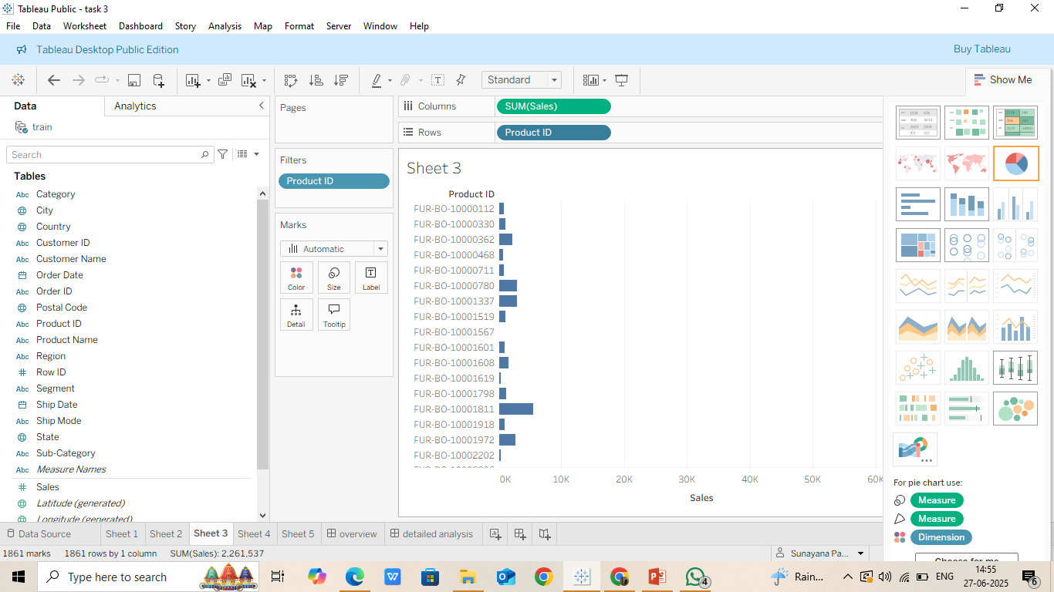
SALES BY PRODUCT ID
Each Product ID represents a unique item in the catalog.
A small group of products accounts for a large portion of total sales, following the Pareto principle (80/20 rule).
Products with high sales often belong to categories like Phones,
Chairs, or Storage.
Several Product IDs show low or no sales, suggesting low demand,
pricing issues, or poor visibility.
This view helps identify: (i) Top-selling products to prioritize for
promotions or inventory restocking. (ii) Low-performing items that
may need review or removal.

Slide 7
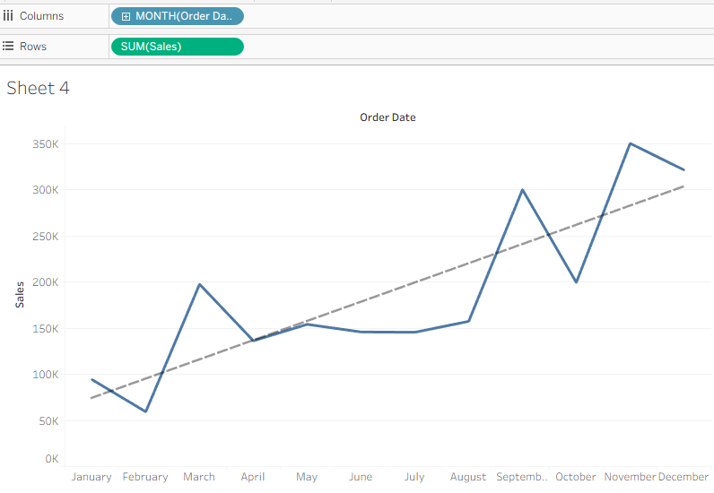
SALES TREND OVER TIME
The X-axis represents the months of the year.
The Y-axis shows the total sales value for each
month.
A trend line has been added to indicate the
overall direction of sales growth.
Sales show fluctuations across different months,
with noticeable peaks around March and September.
The trend line indicates a steady upward movement,
suggesting positive growth over time.
This visualization helps identify seasonal patterns and
high-performing months, which are useful for sales
planning and forecasting

Slide 8
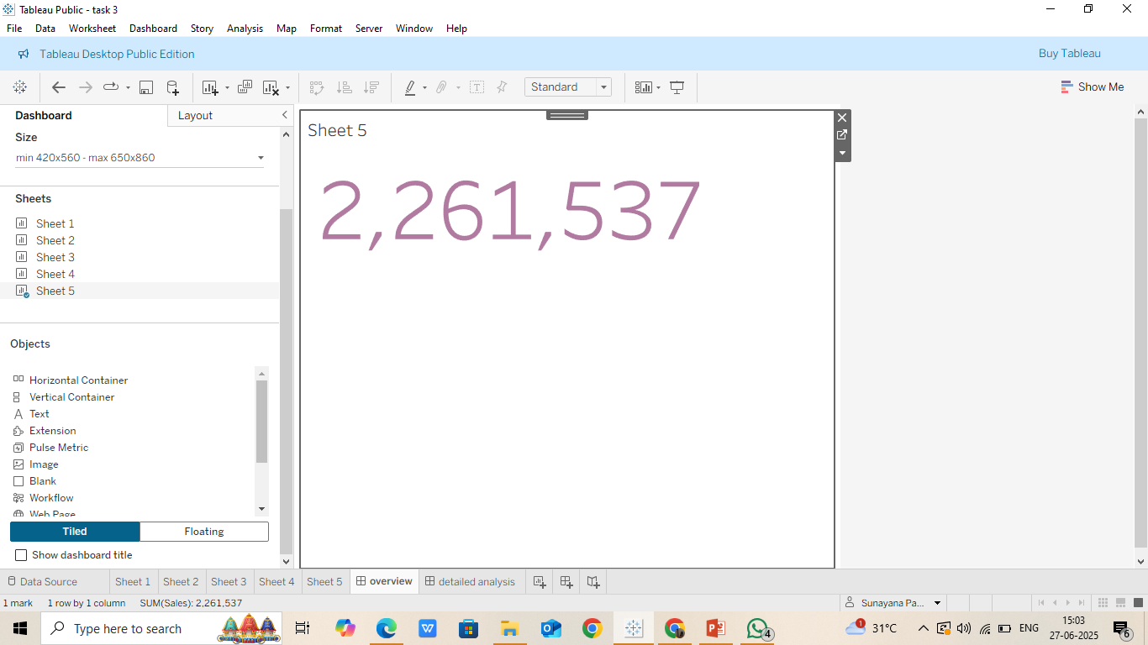
OVERVIEW DASHBOARD
Quickly understand overall business performance.
Support strategic decisions with clear, visual summaries.
Serve as a gateway to detailed dashboards.

Slide 9
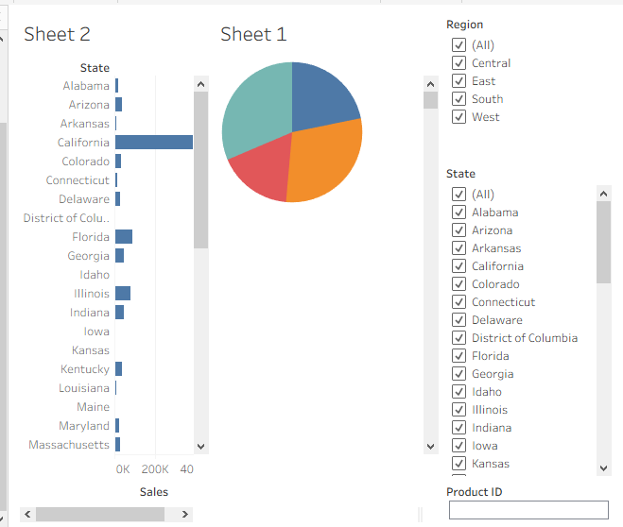
DETAILED ANALYSIS DASHBOARD
The Detailed Analysis Dashboard dives deeper into specific dimensions of the business, such as state-wise, product-wise, and category-wise performance.
INSIGHTS GAINED :
Concentrated sales in specific product categories and states.
Some sub-categories (e.g., Tables) may show high sales but low profit.
Helps in refining marketing strategy, inventory planning, and pricing.

Slide 10
INSIGHTS AND OBSERVATIONS
Western region has highest sales but low profit.
Office Supplies shows consistent growth.
Profitability varies by segment and shipping mode.
Interactive Dashboard link : https://public.tableau.com/app/profile/sunayana.panigrahi/viz/task3_17510116411070/detailedanalysis?publish=yes
THANK YOU

Slide 11
CONCLUSION
Tableau makes it easy to explore business performance visually.
It helps identify trends, low-performing areas, and future opportunities

